Slide 1
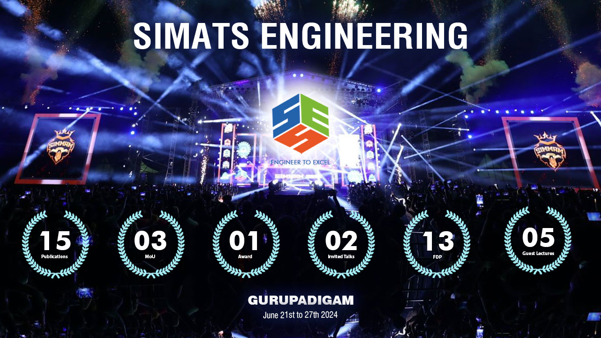

Slide 2
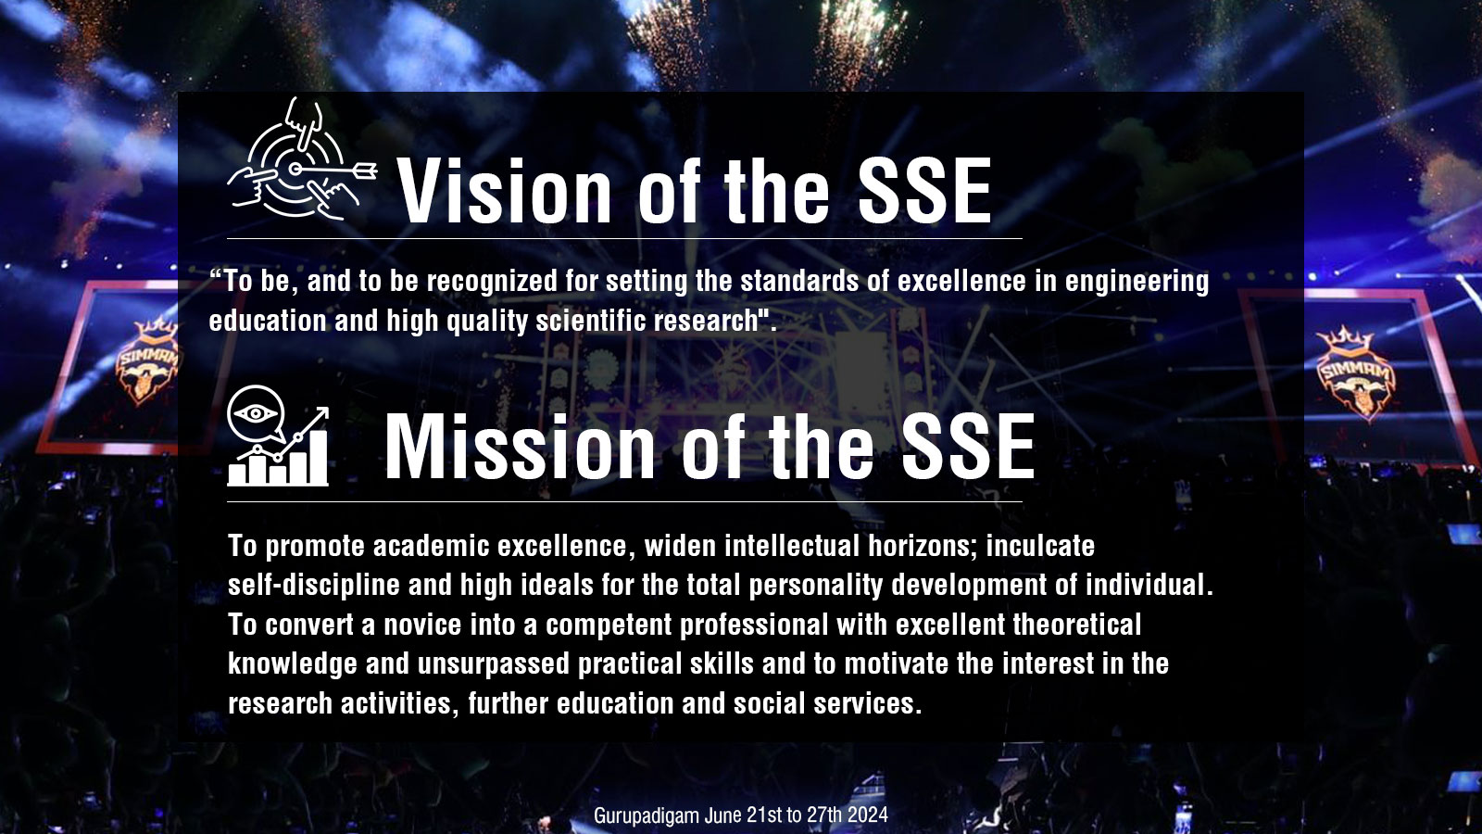

Slide 3
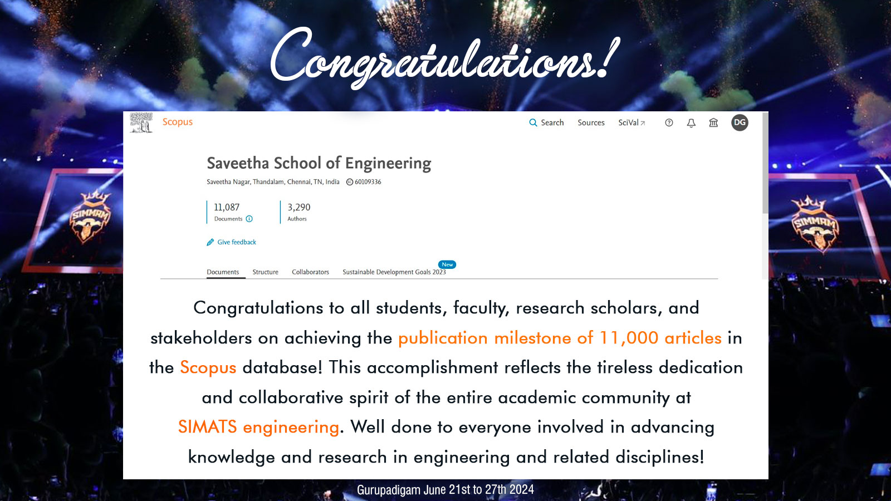

Slide 4
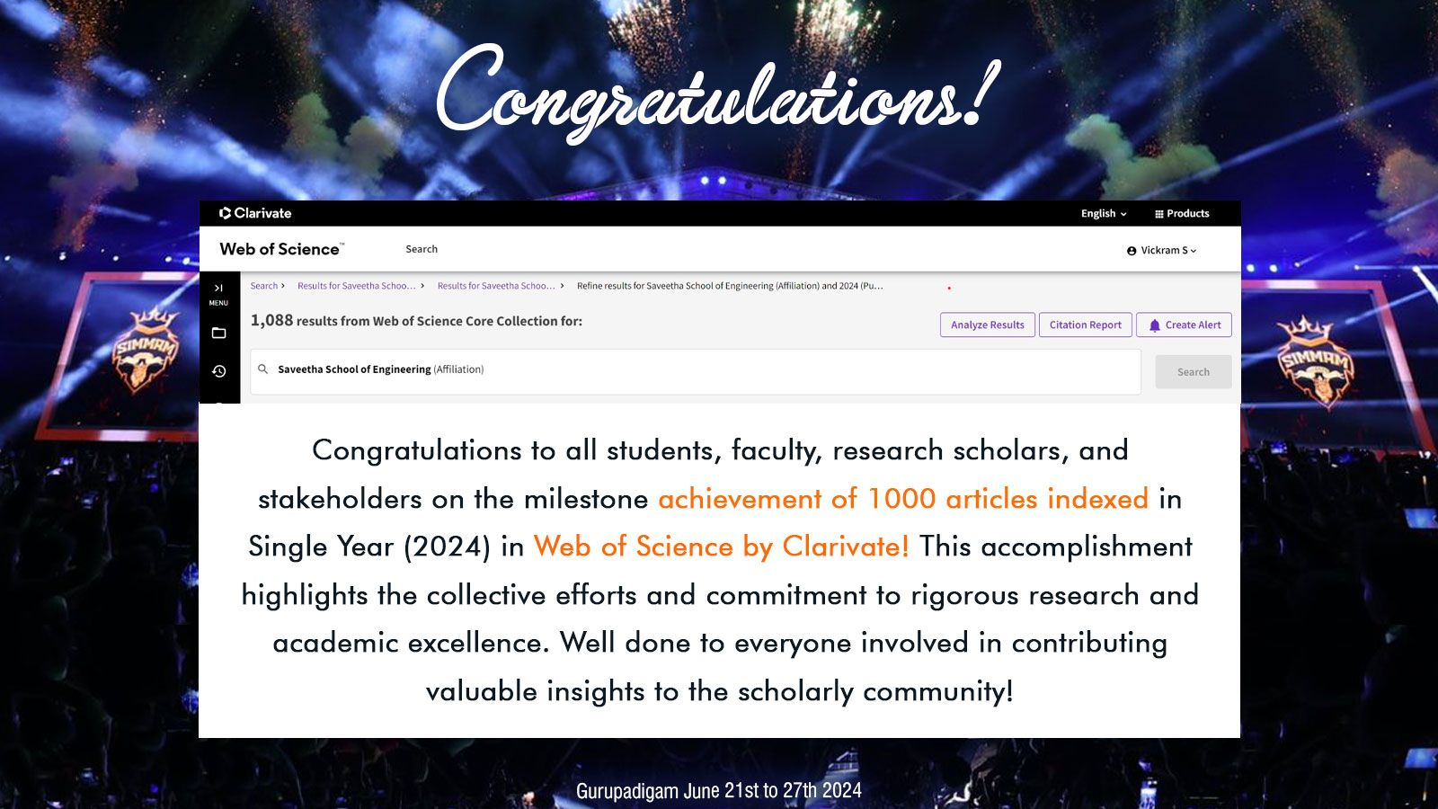

Slide 5
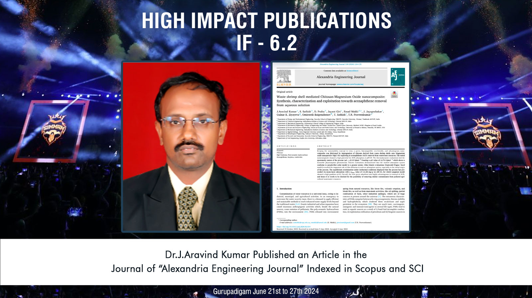

Slide 6
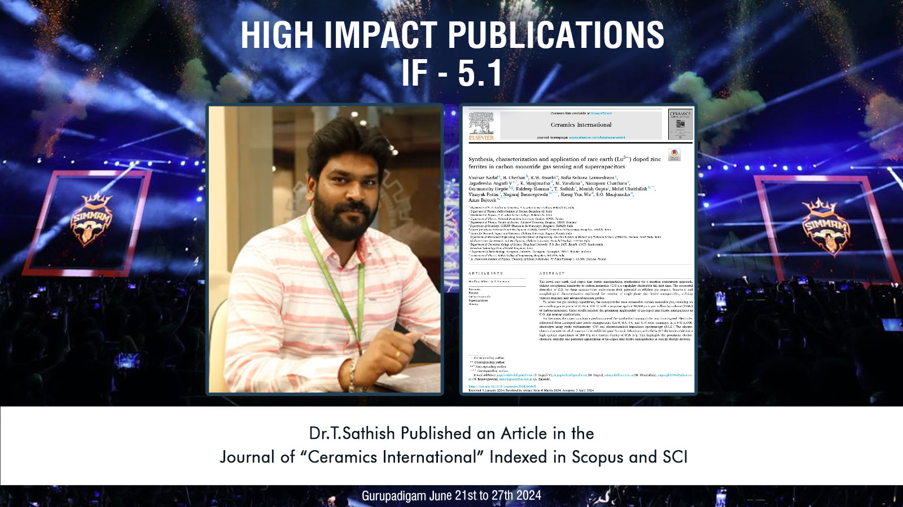

Slide 7
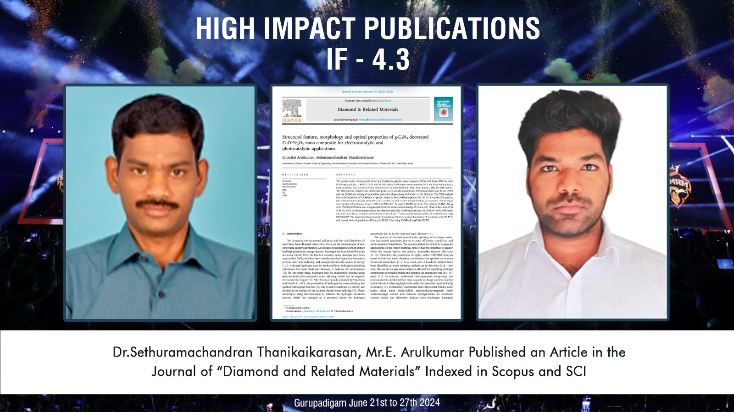

Slide 8
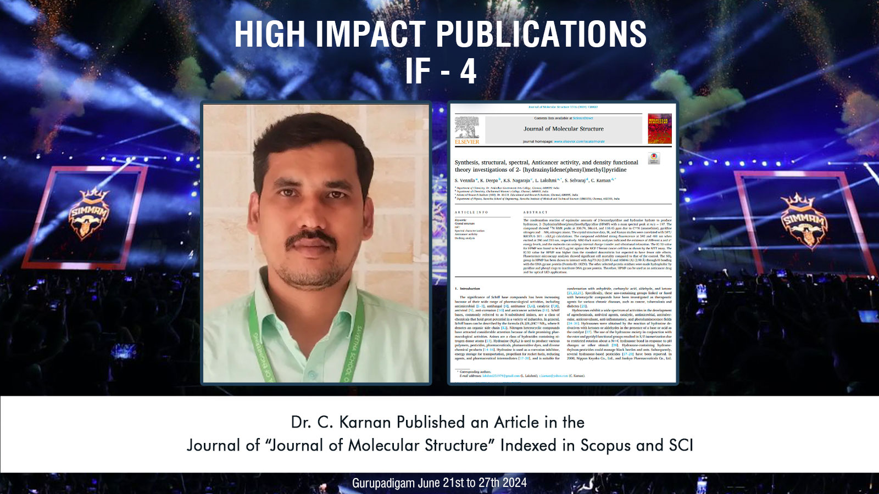

Slide 9


Slide 10
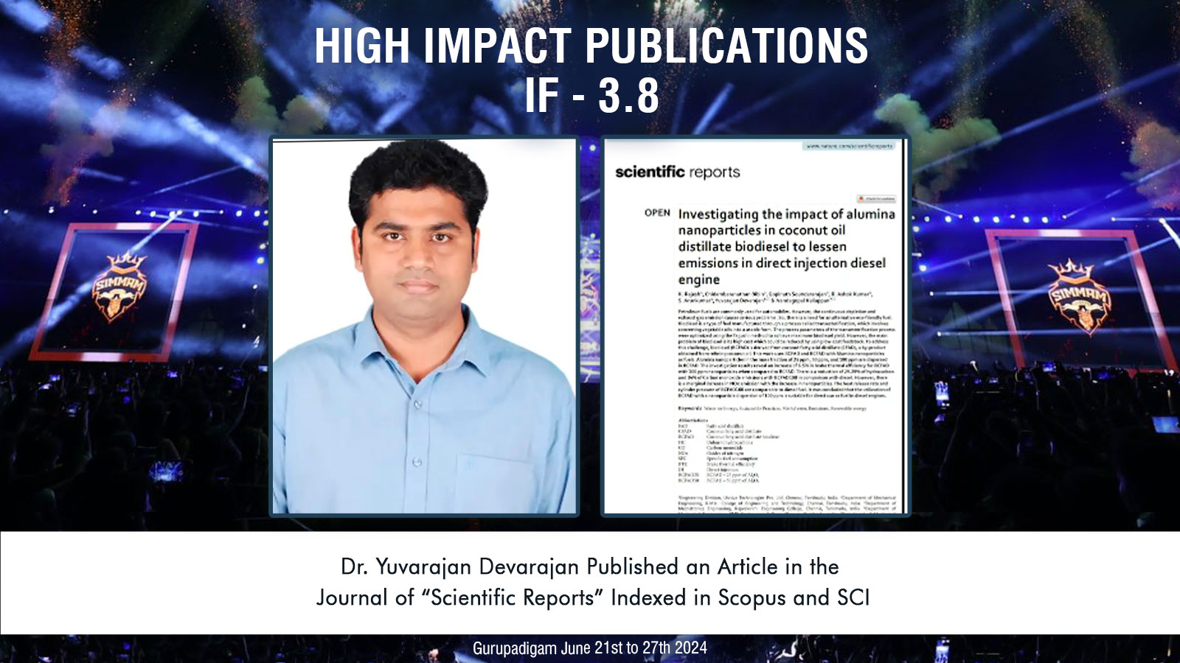

Slide 11
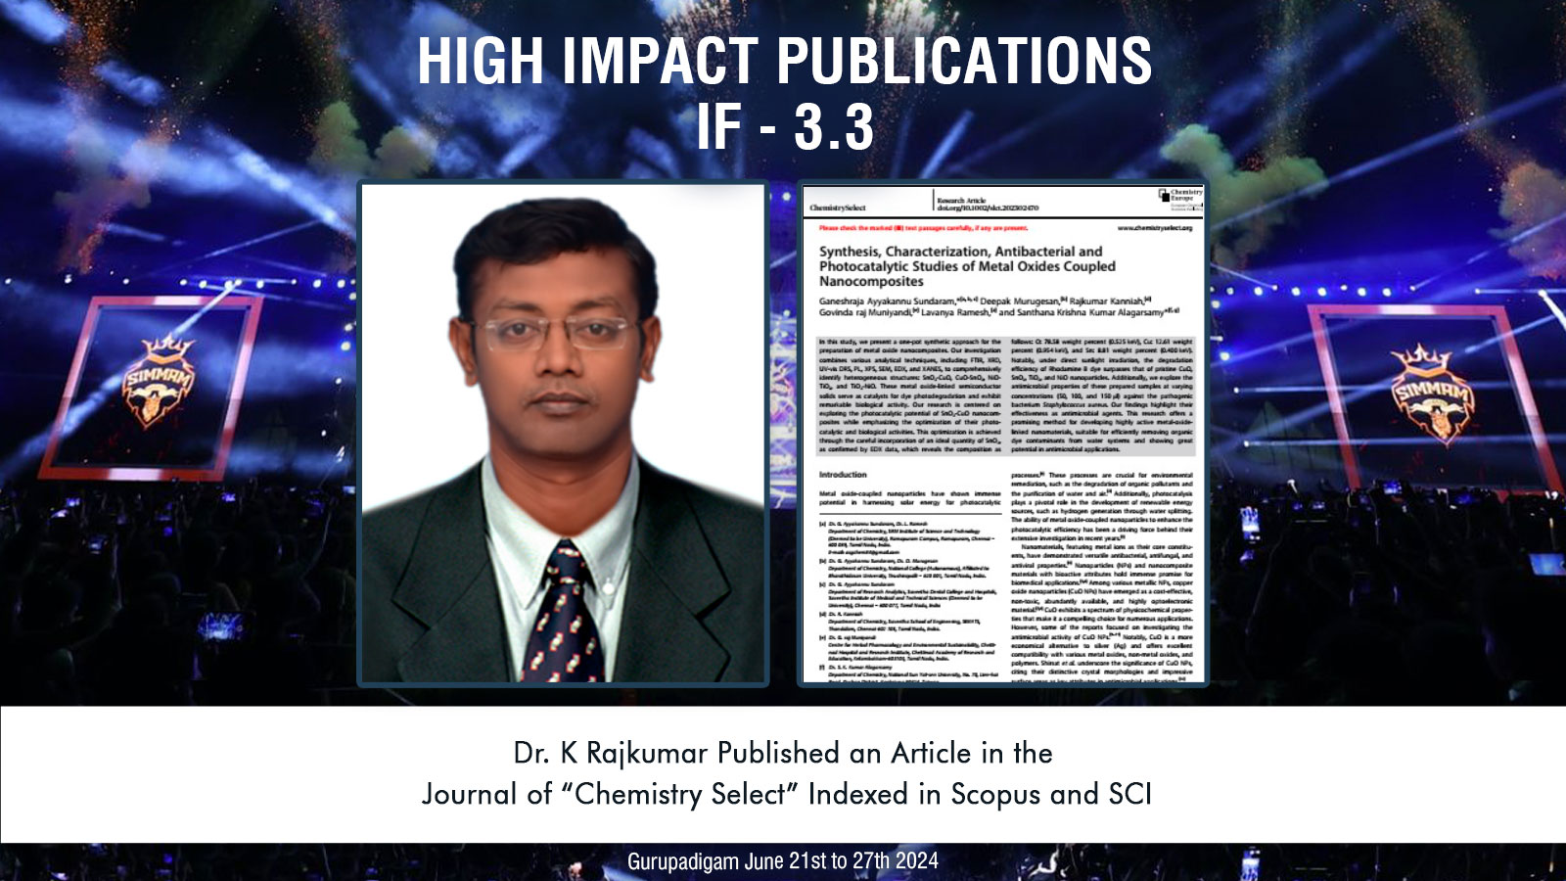

Slide 12
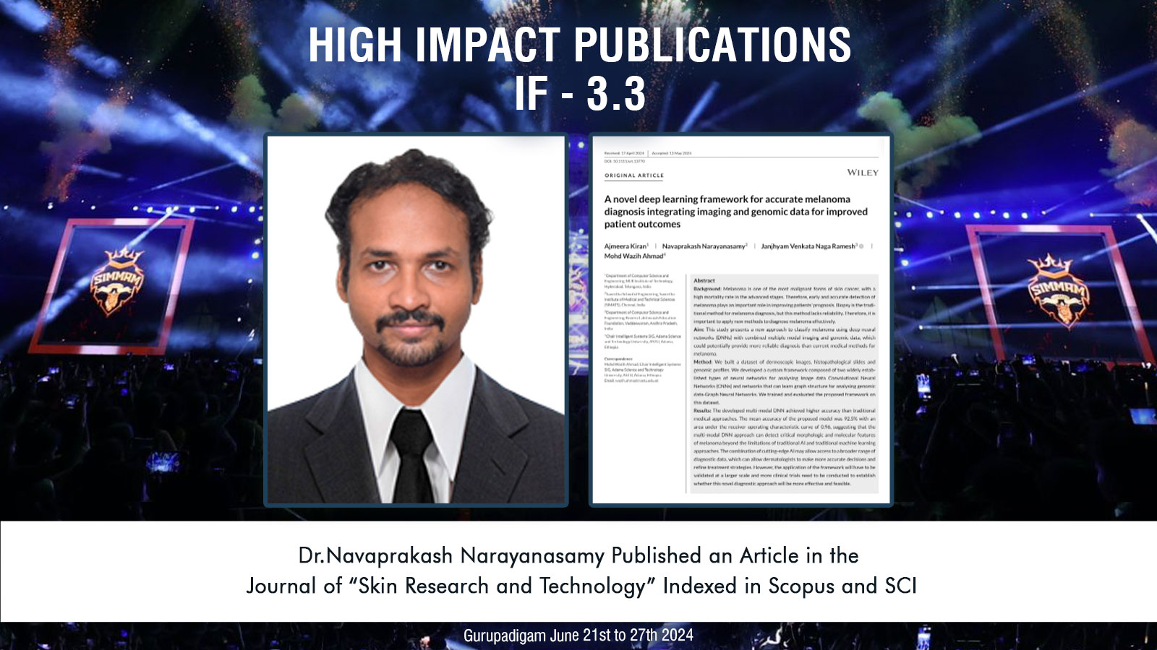

Slide 13
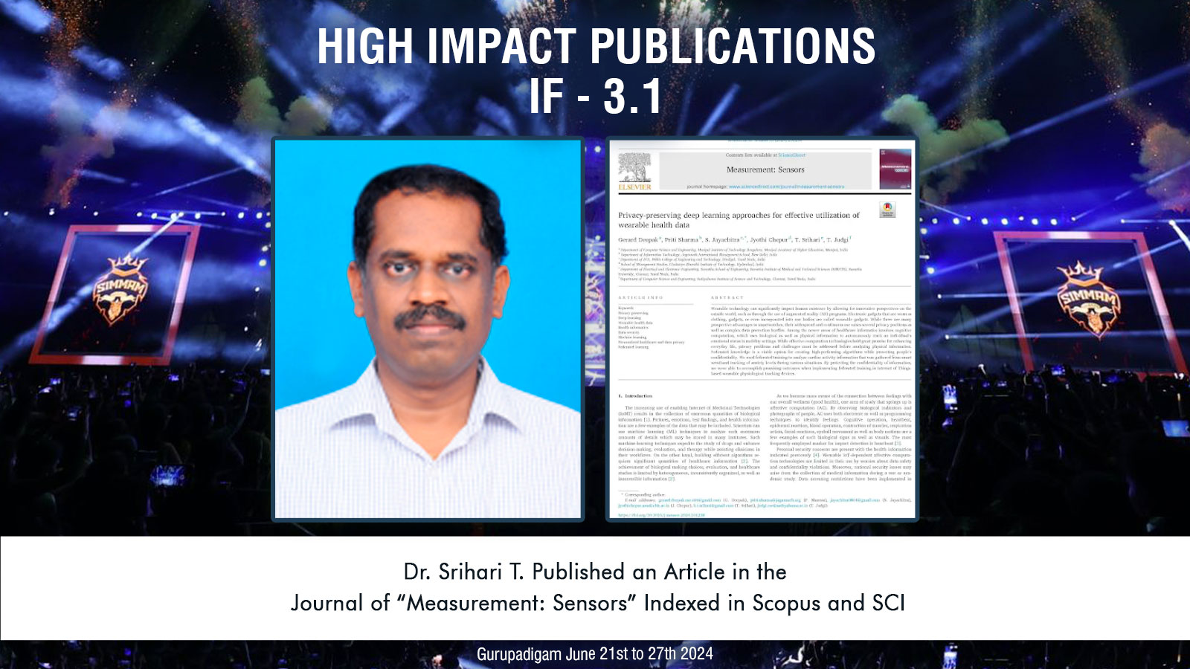

Slide 14
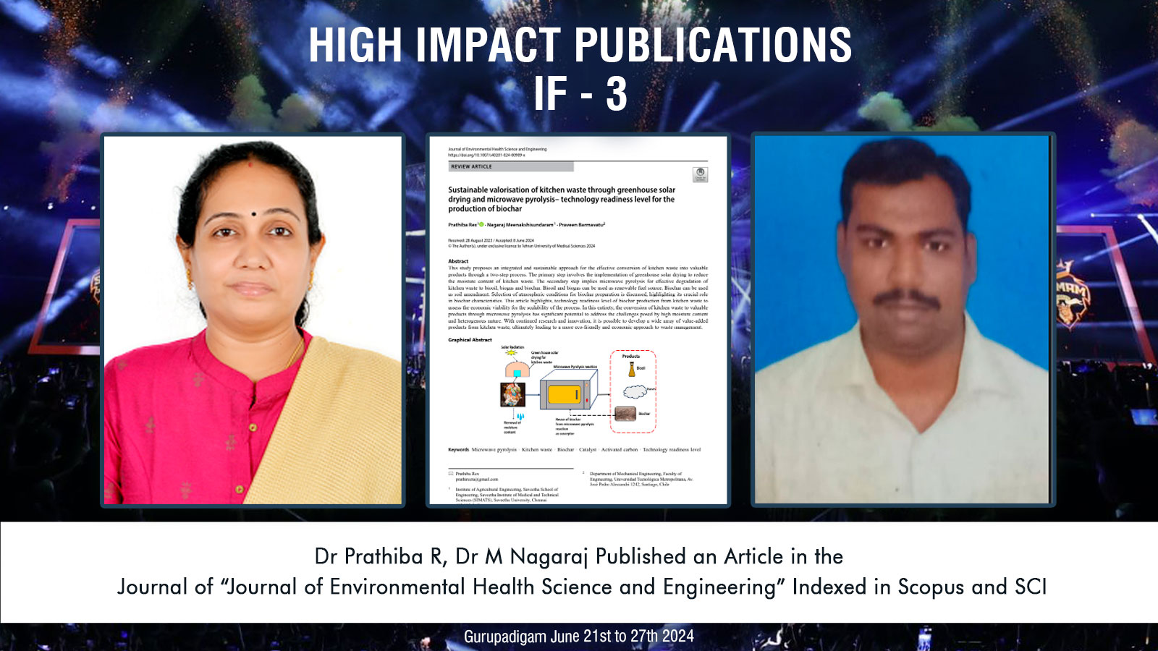

Slide 15
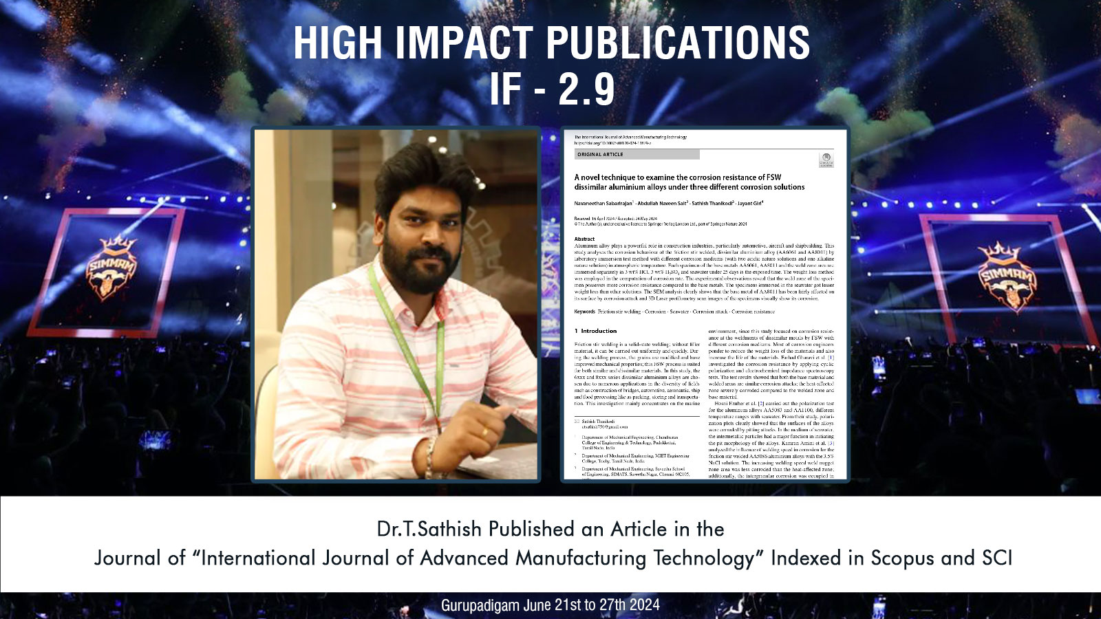

Slide 16
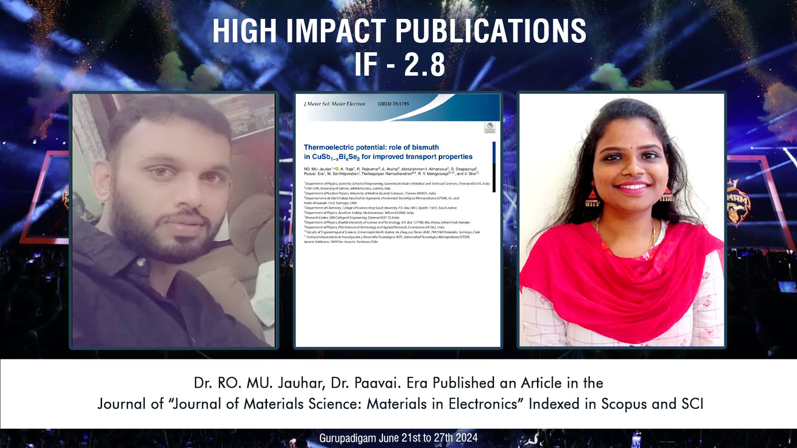

Slide 17
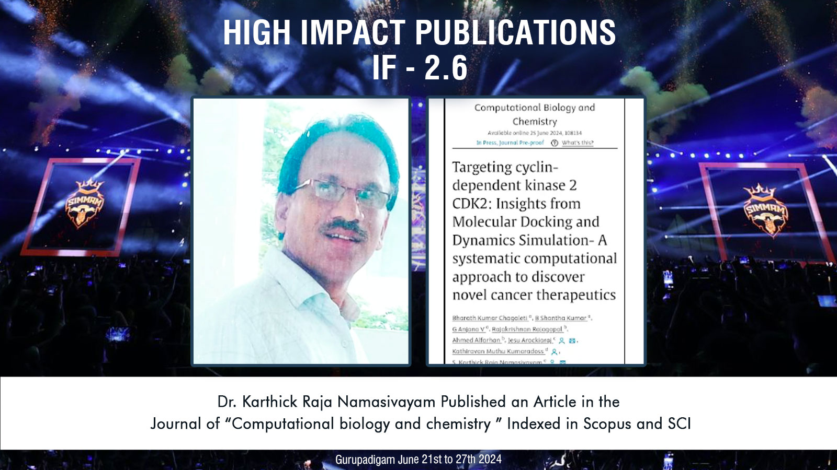

Slide 18
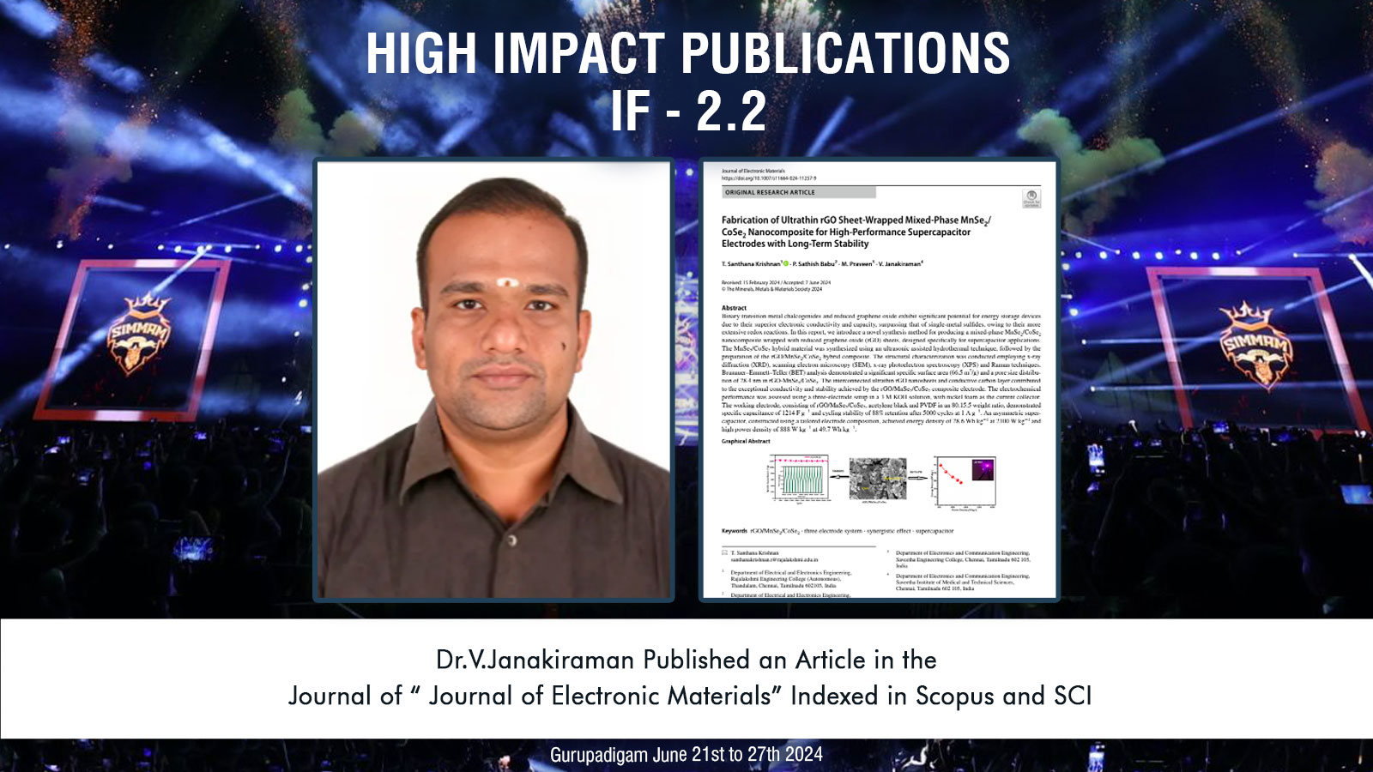

Slide 19
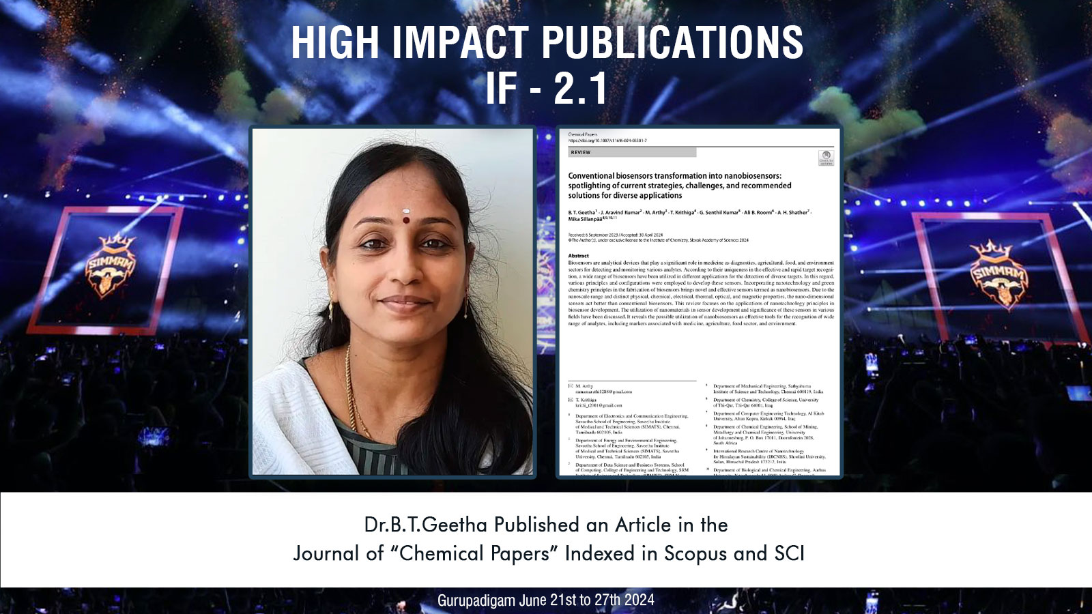

Slide 20
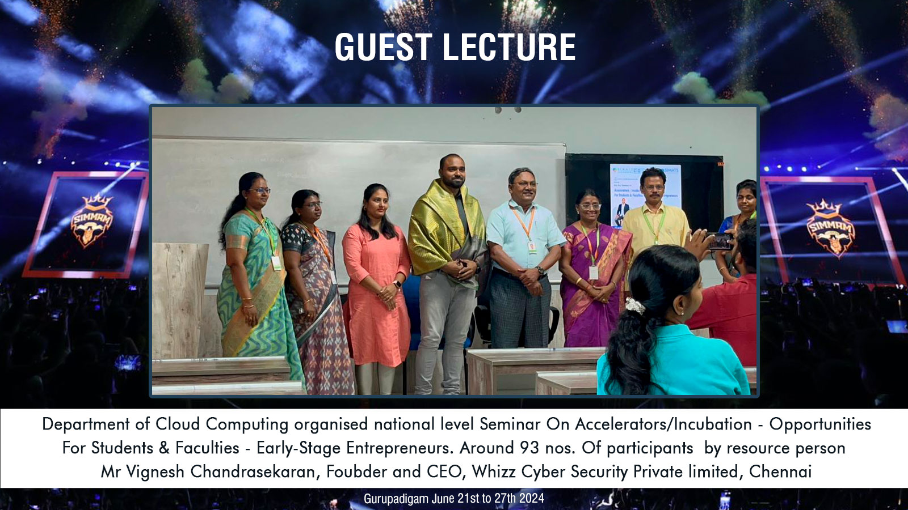

Slide 21
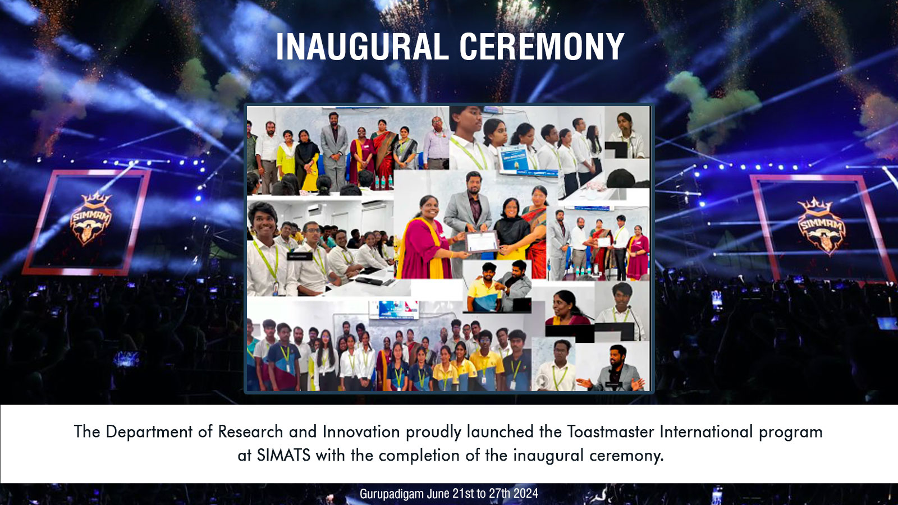

Slide 22
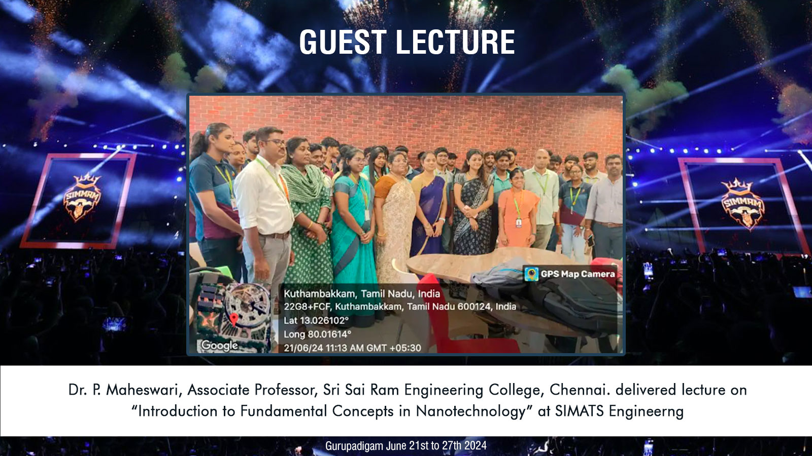

Slide 23
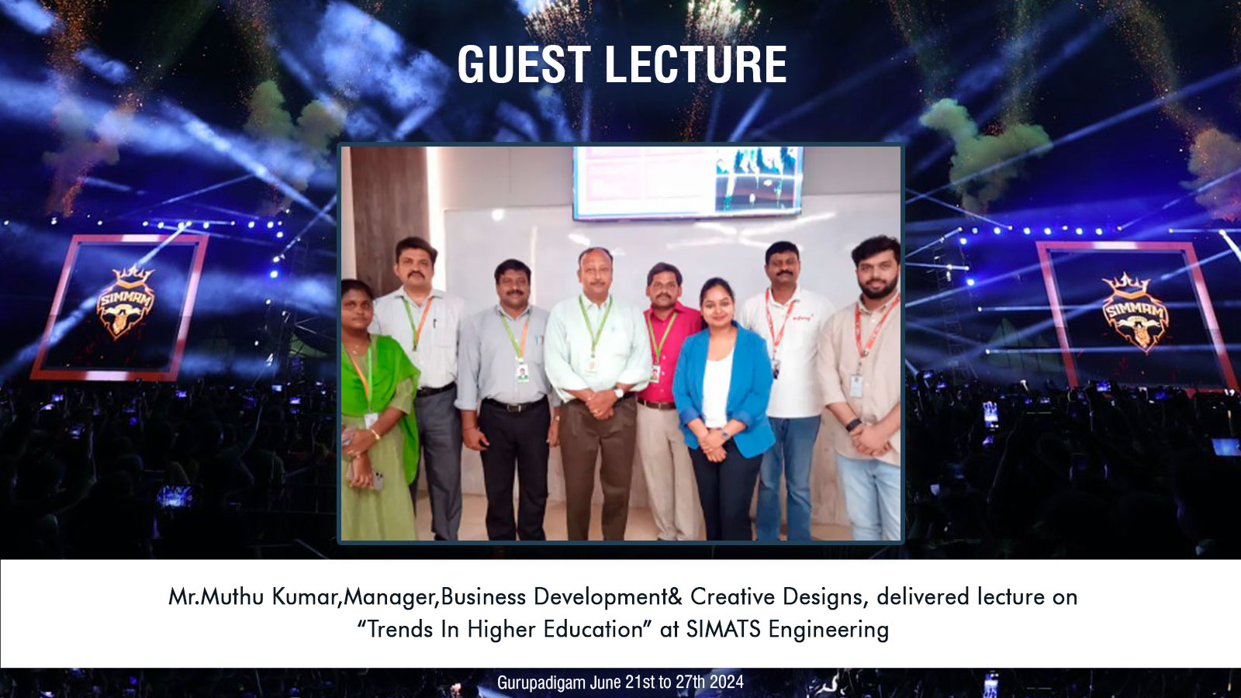

Slide 24
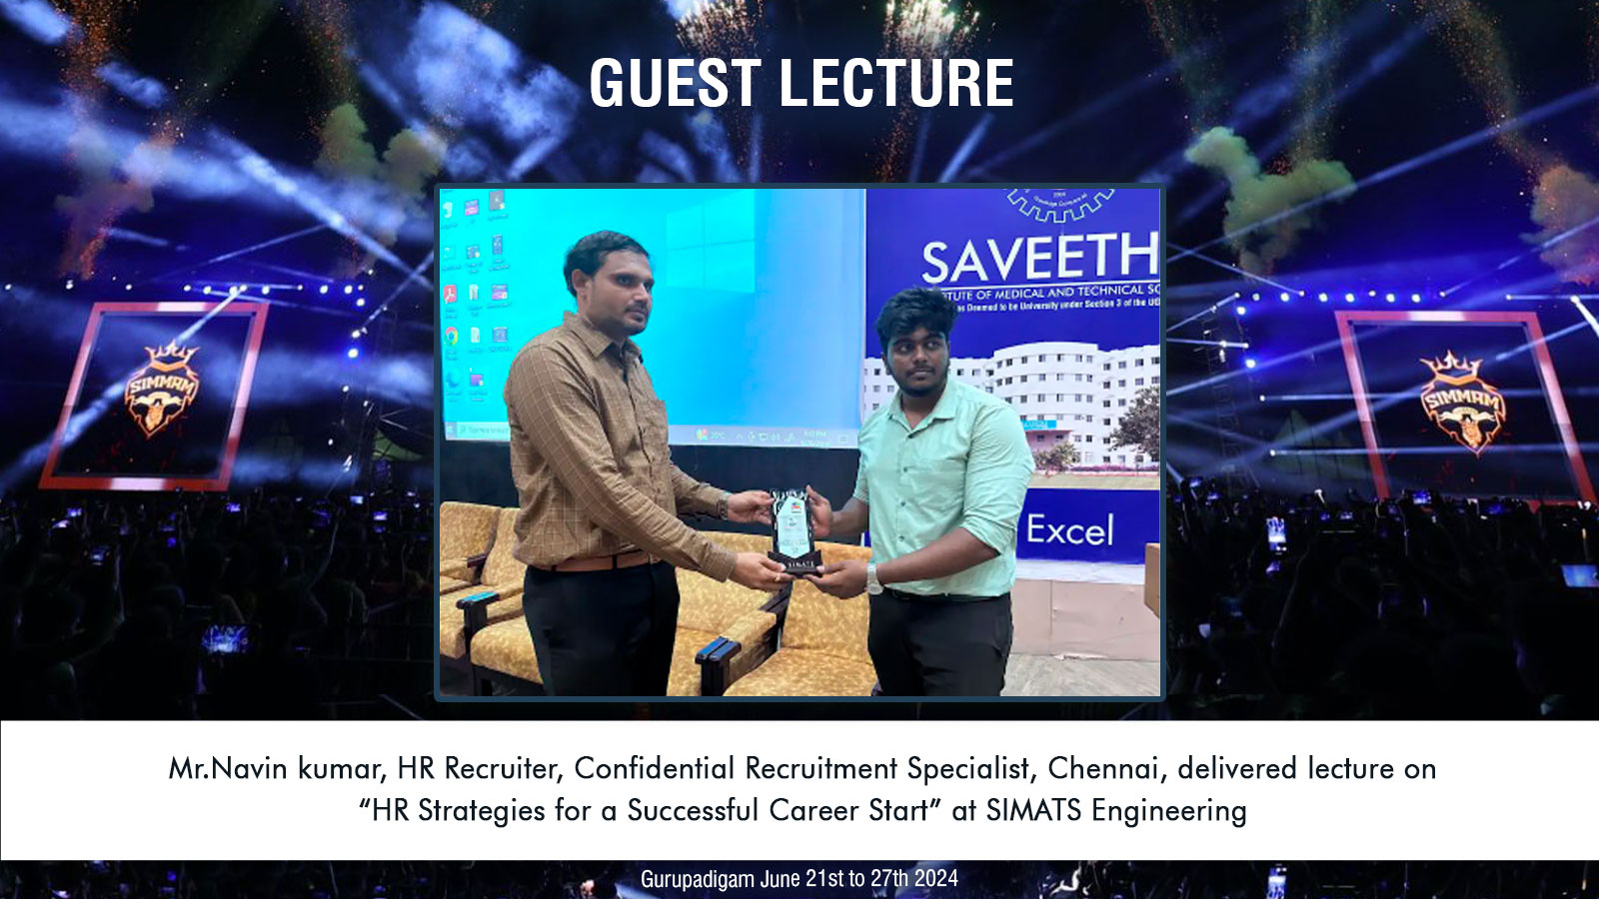

Slide 25
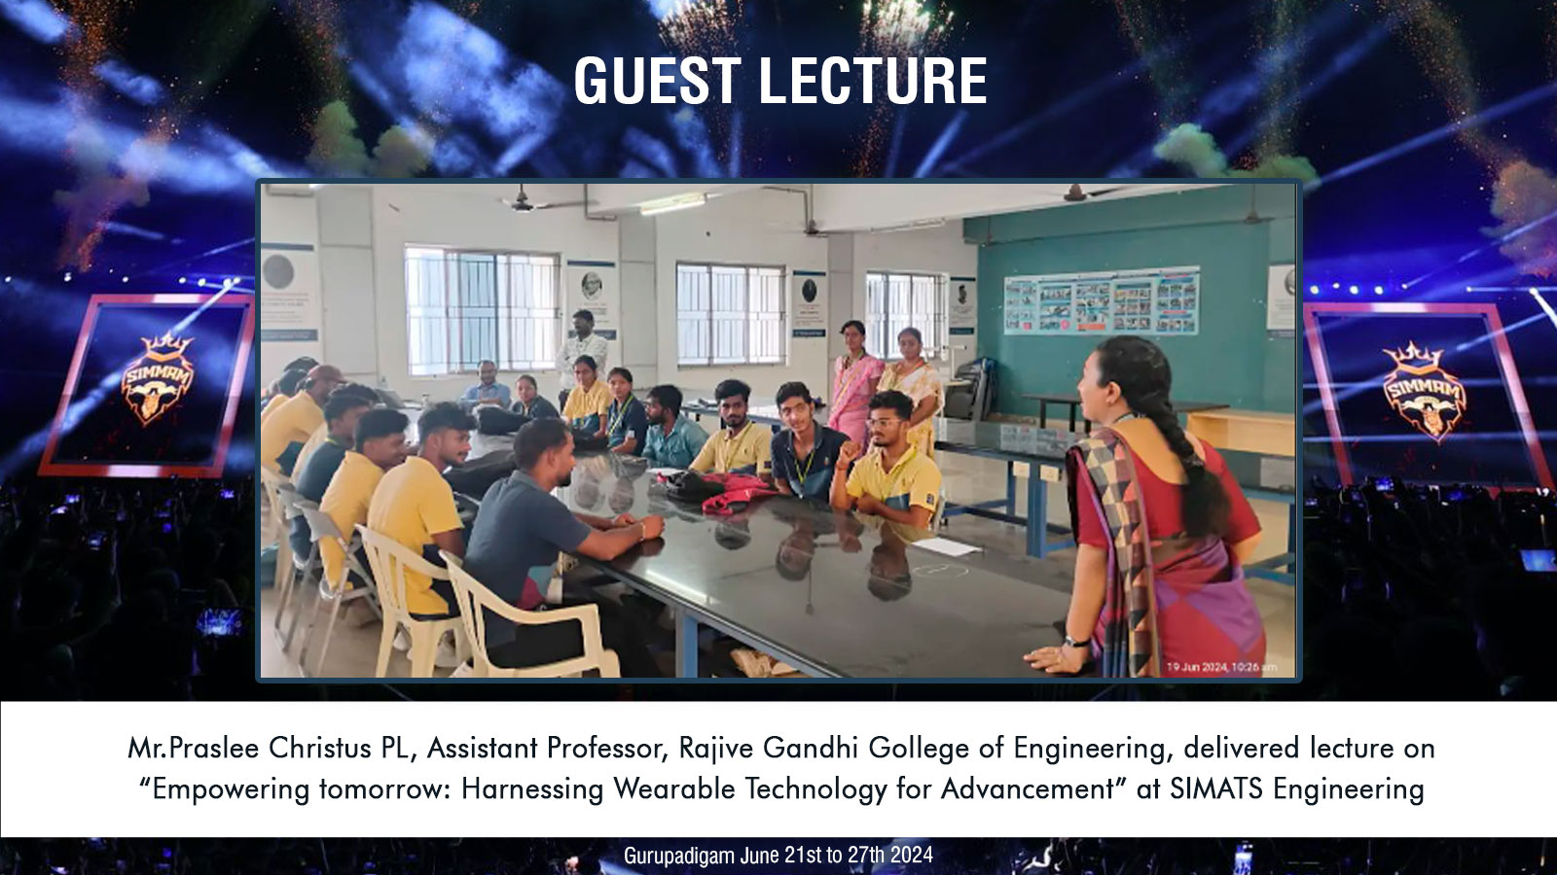

Slide 26
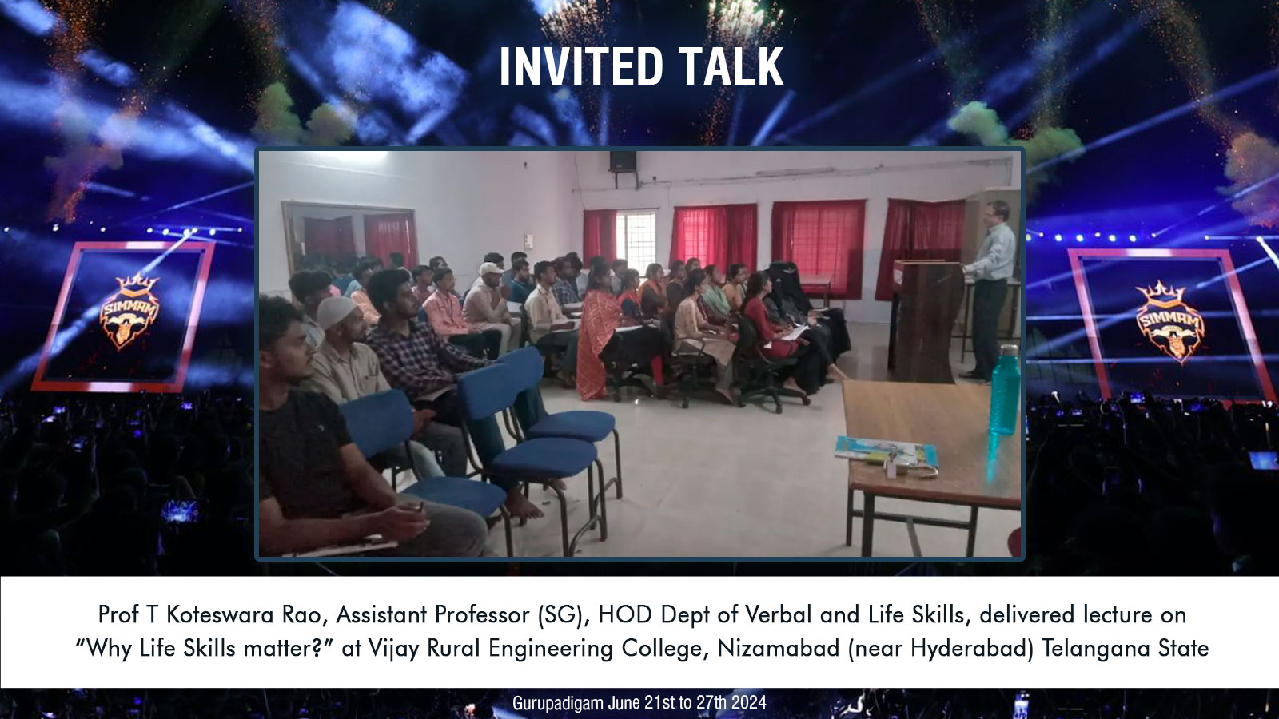

Slide 27


Slide 28
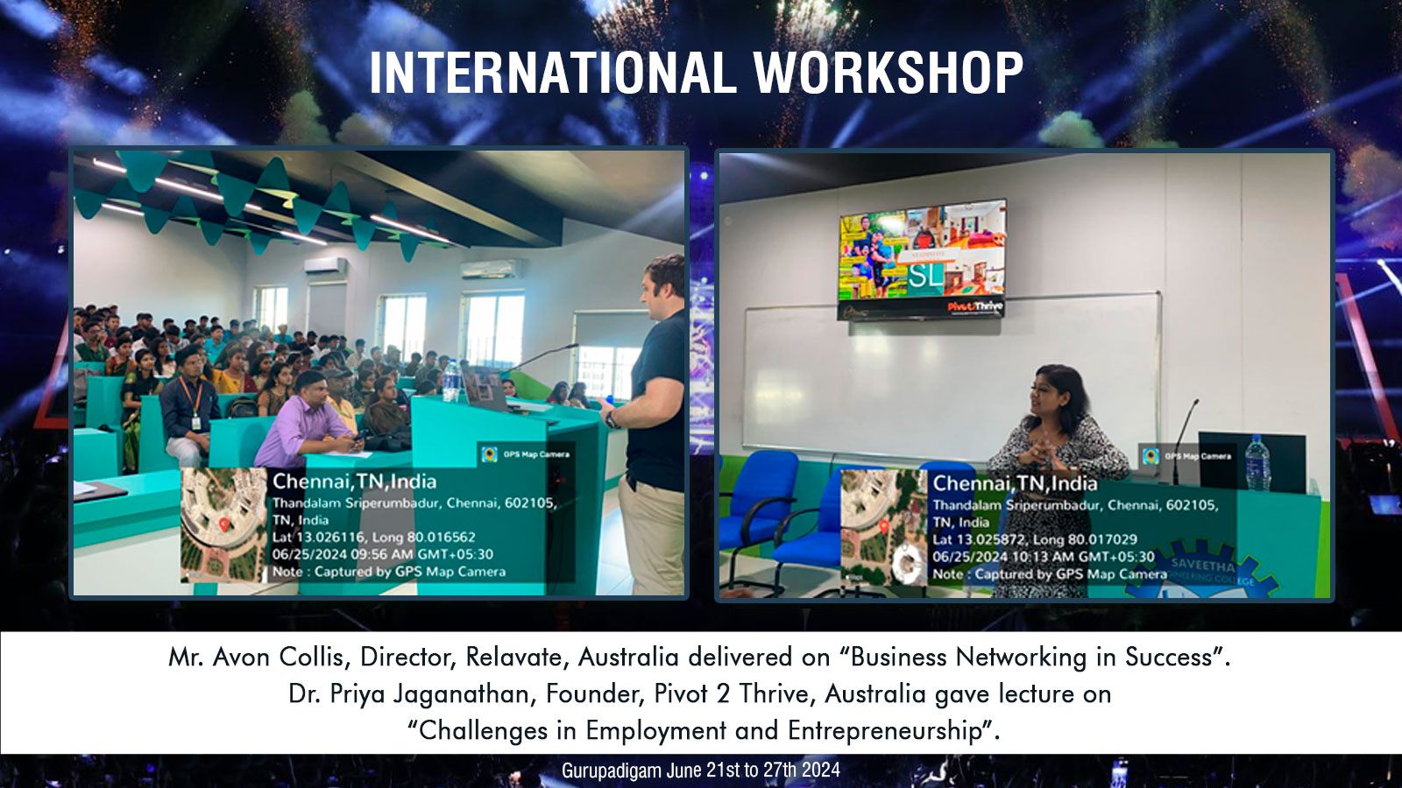

Slide 29
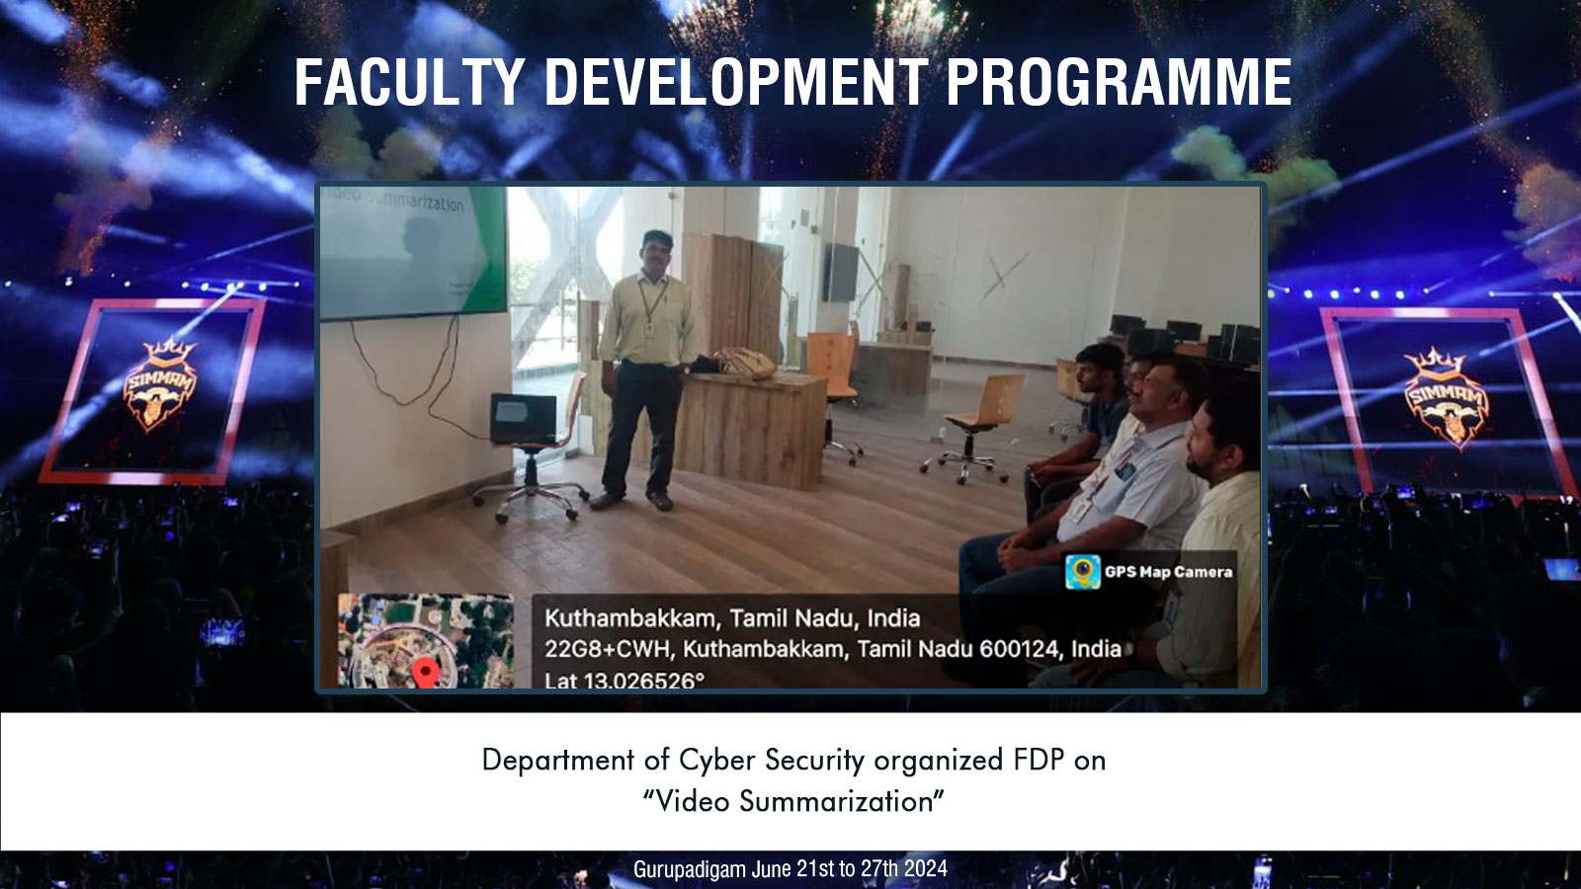

Slide 30
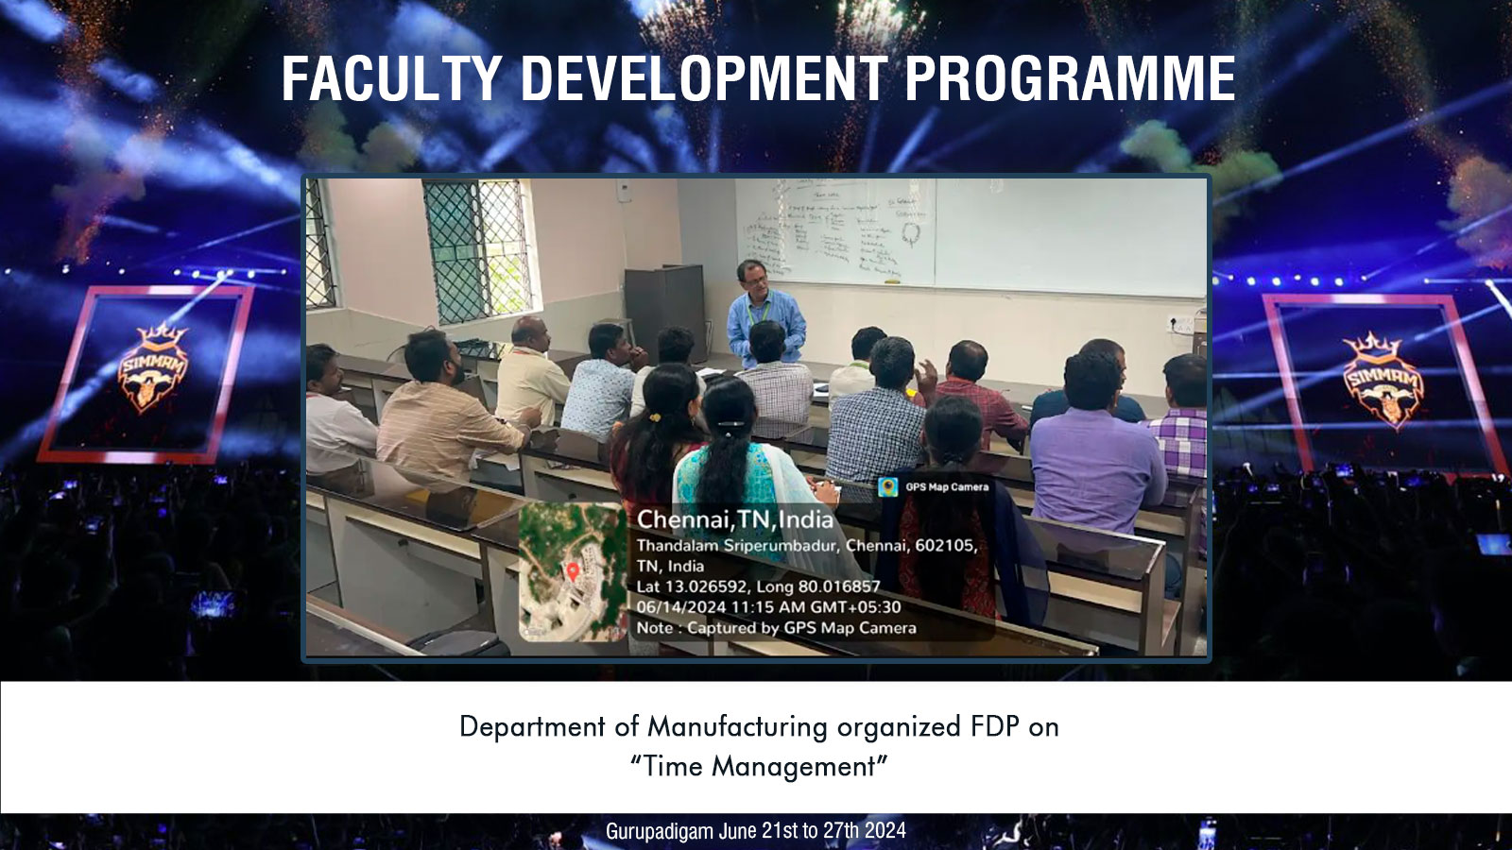

Slide 31
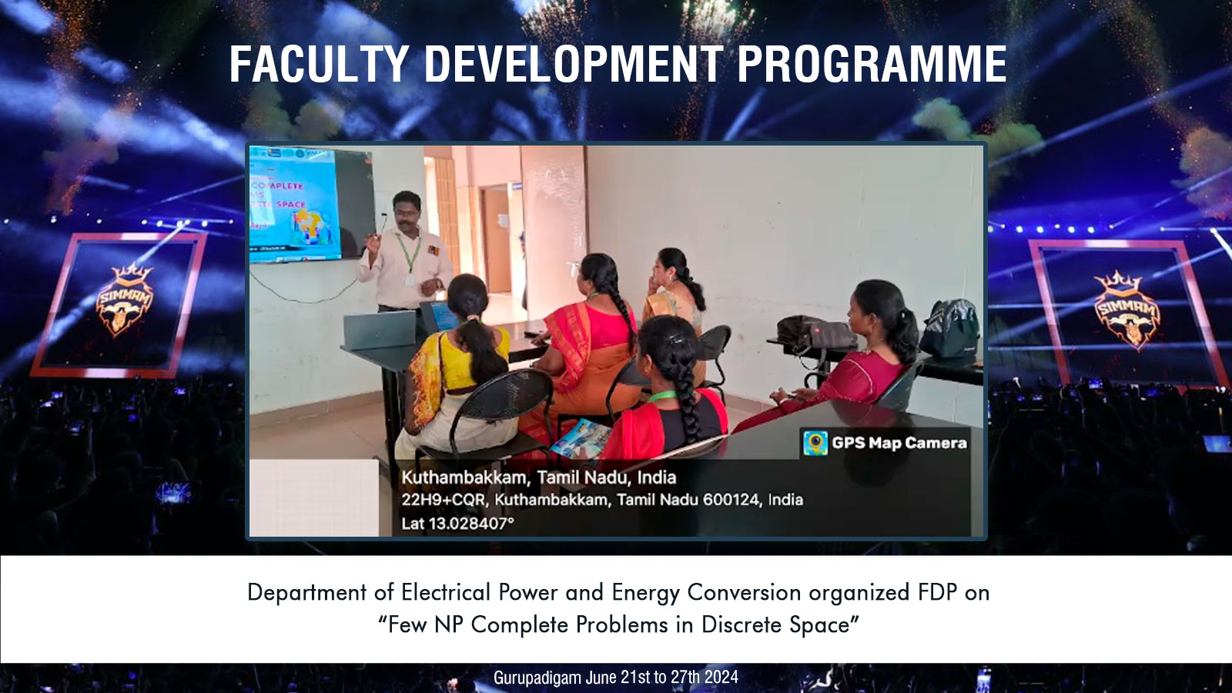

Slide 32
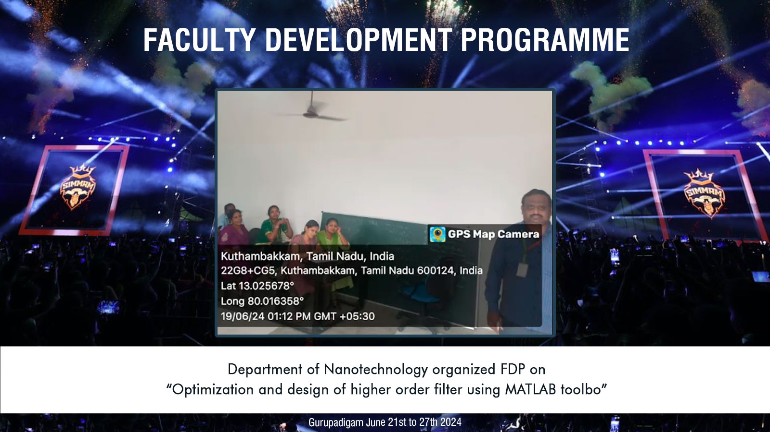

Slide 33
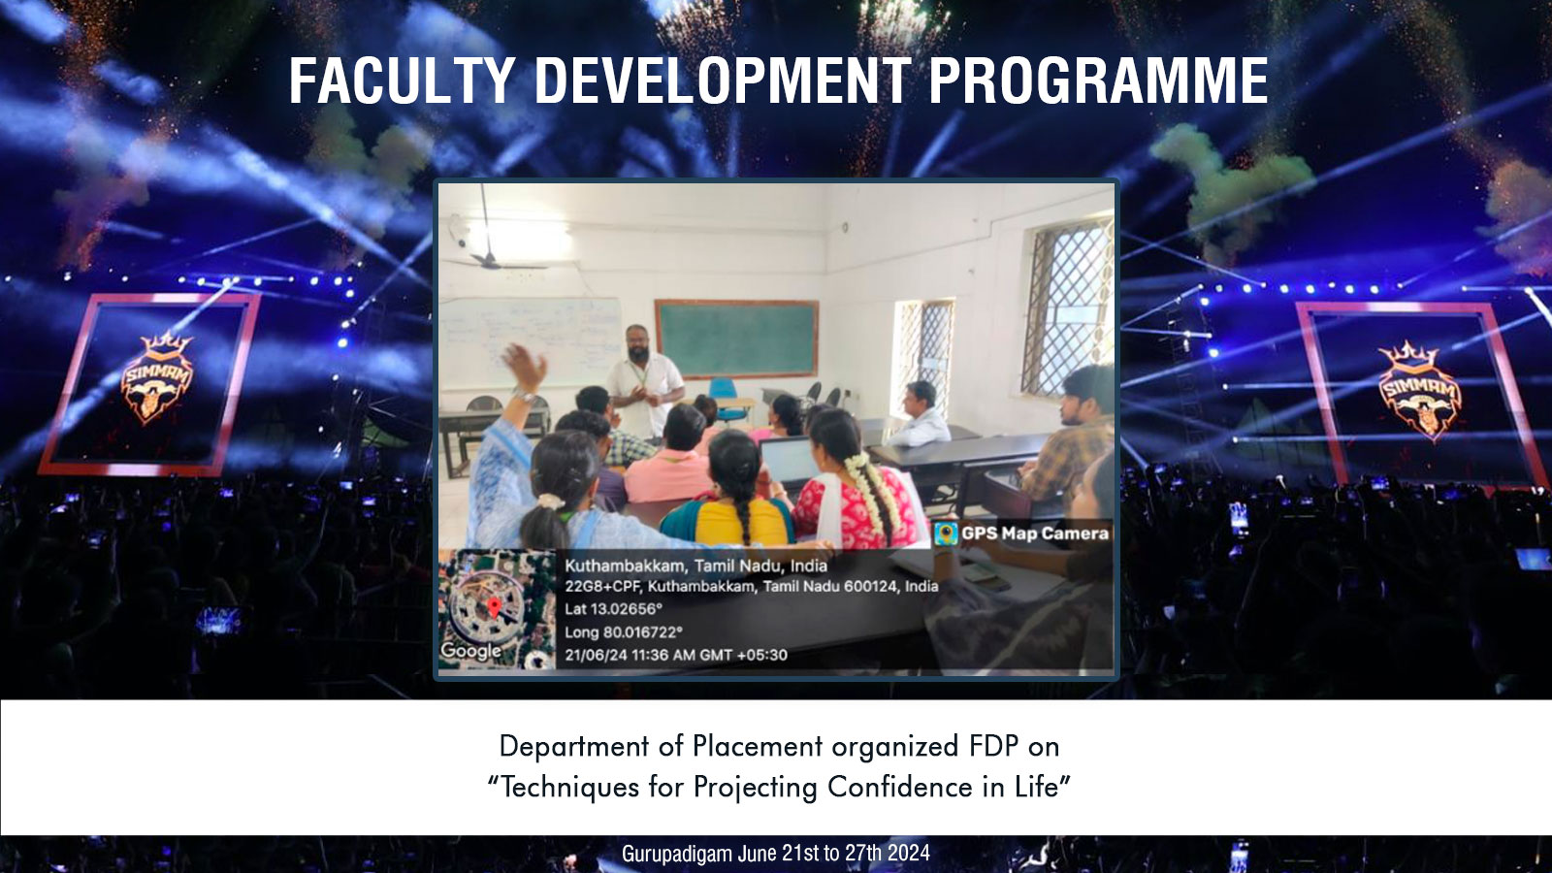

Slide 34
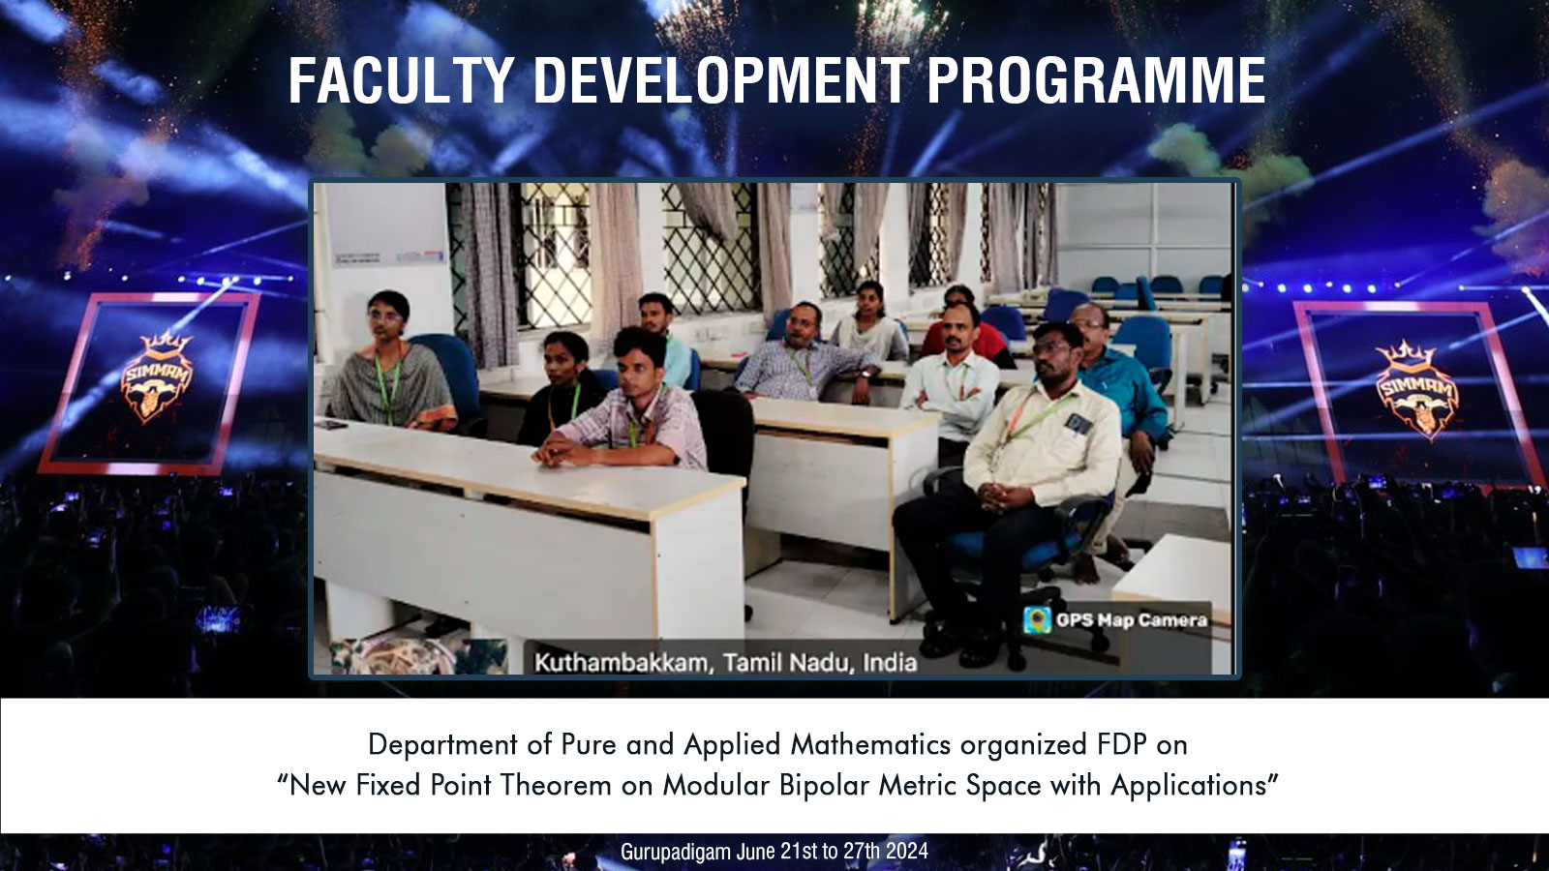

Slide 35
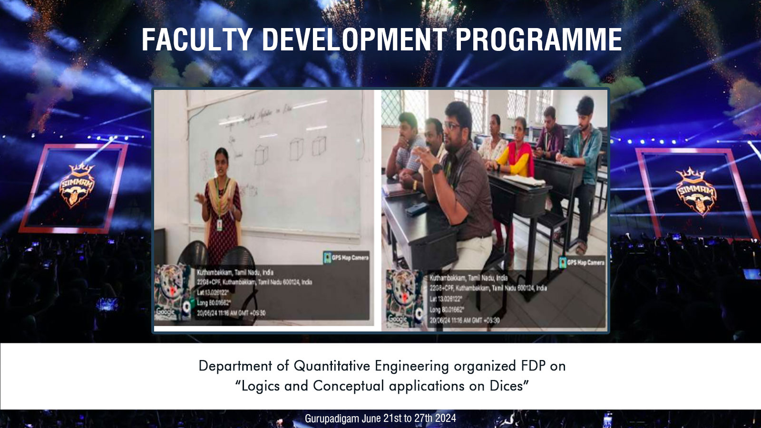

Slide 36
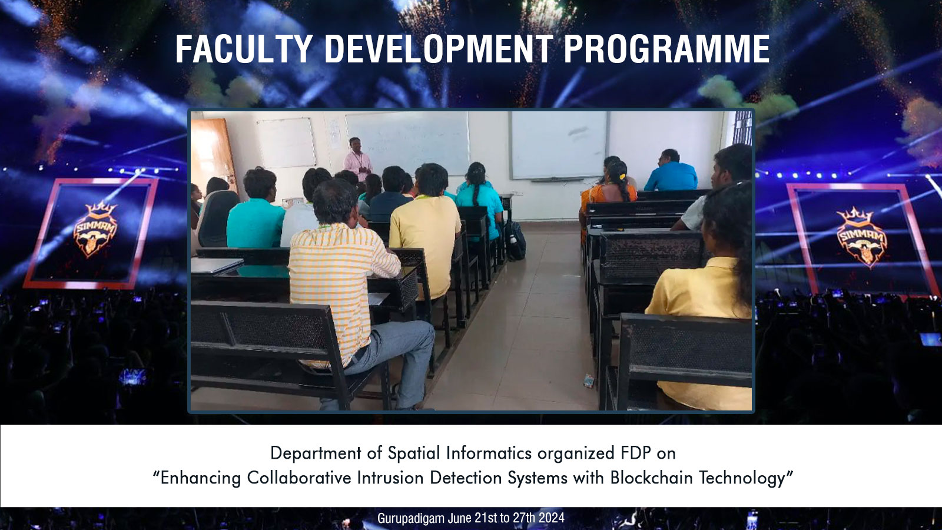

Slide 37
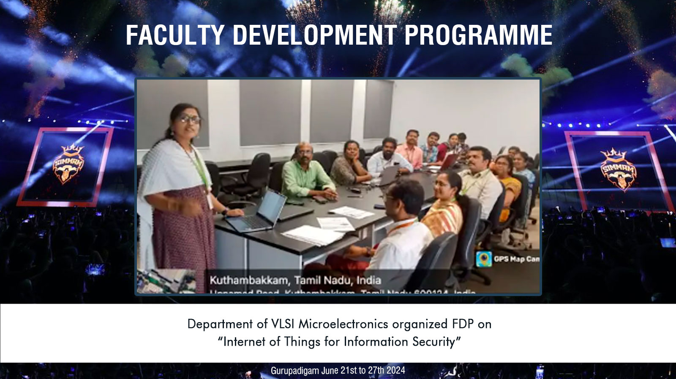

Slide 38
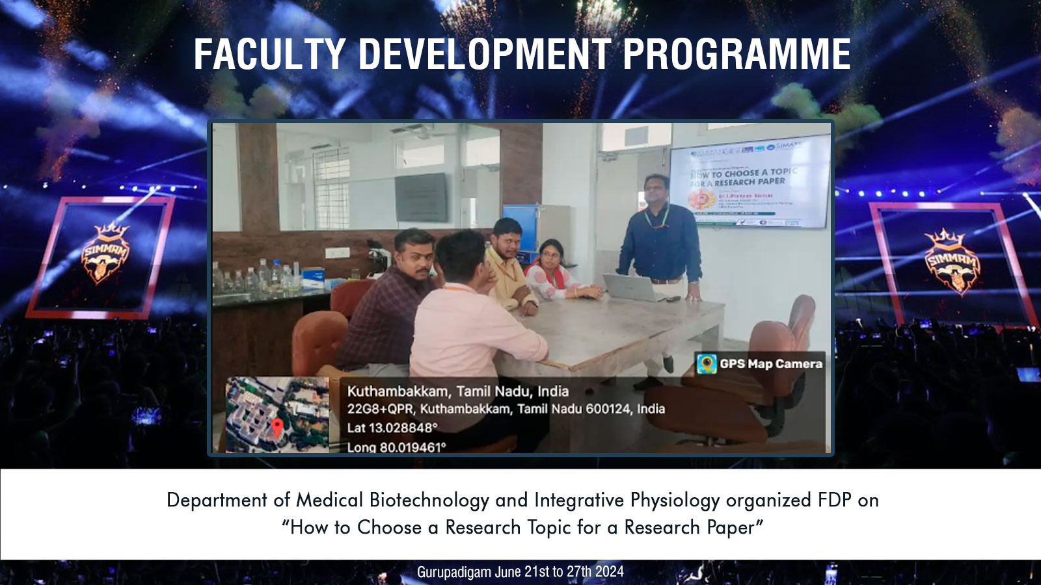

Slide 39
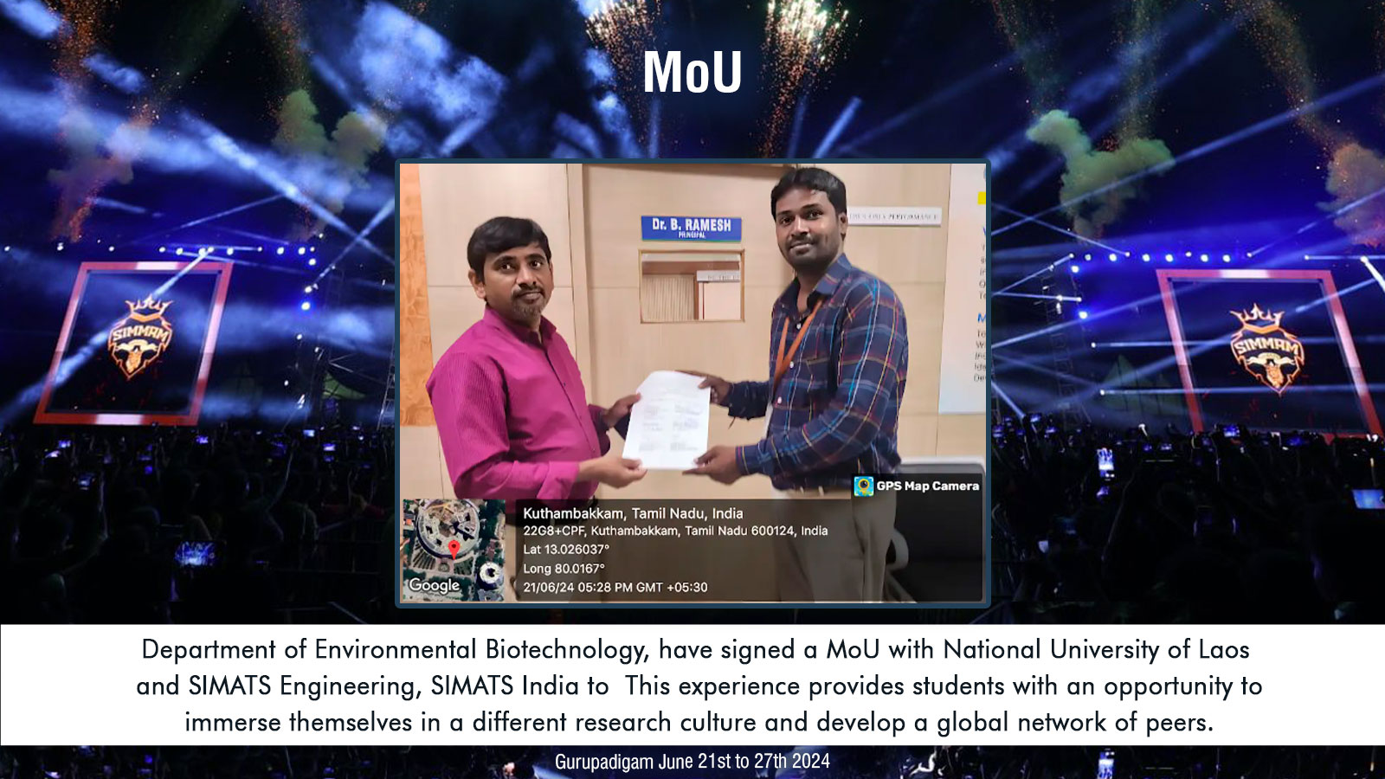

Slide 40
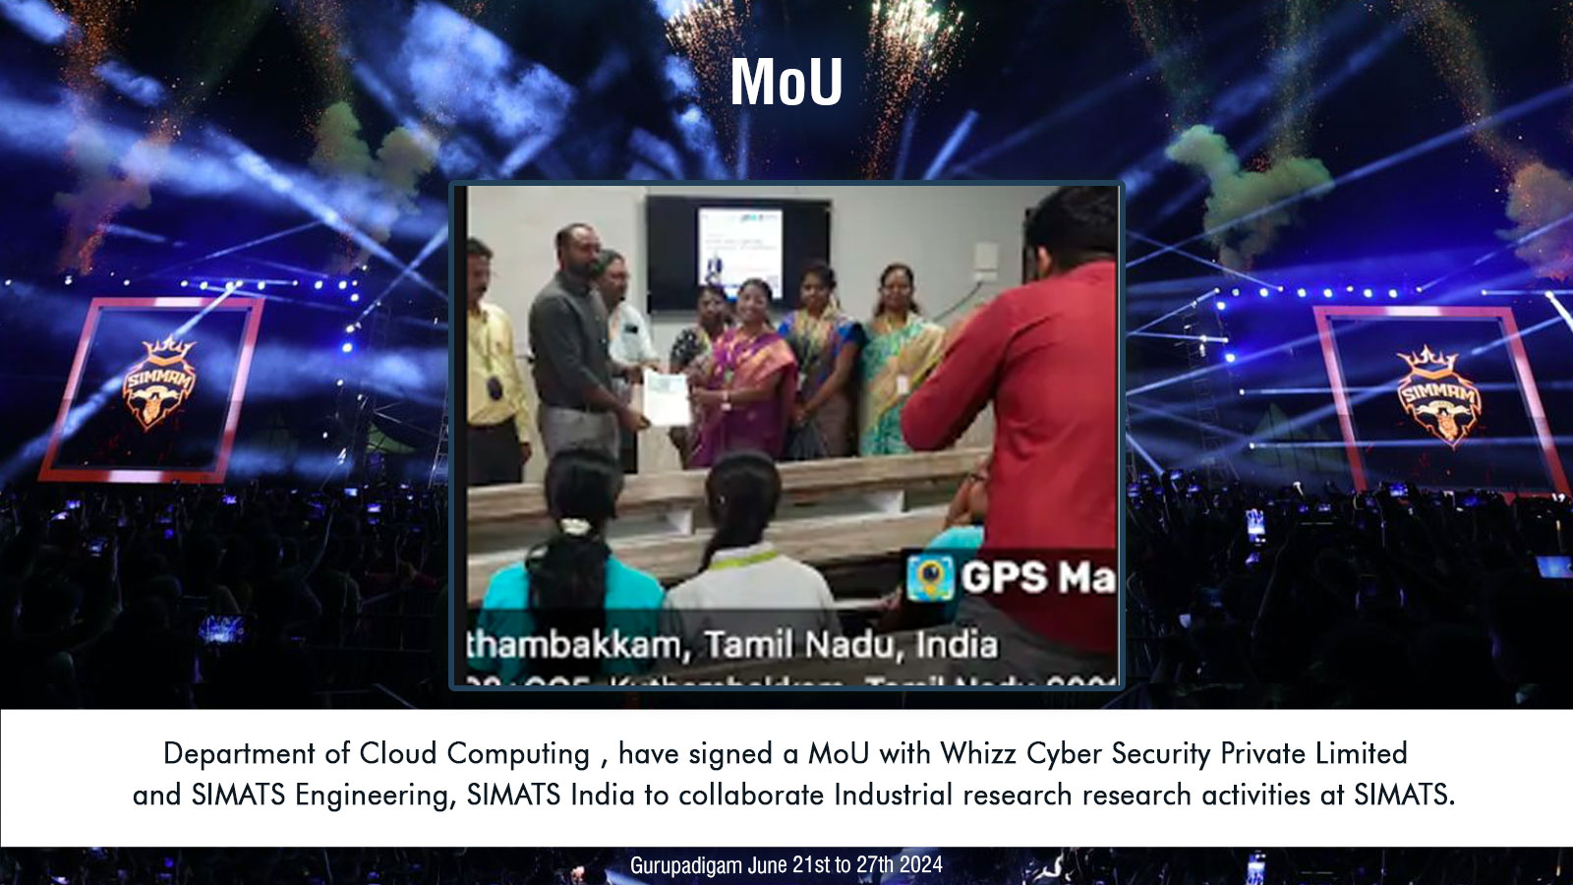

Slide 41
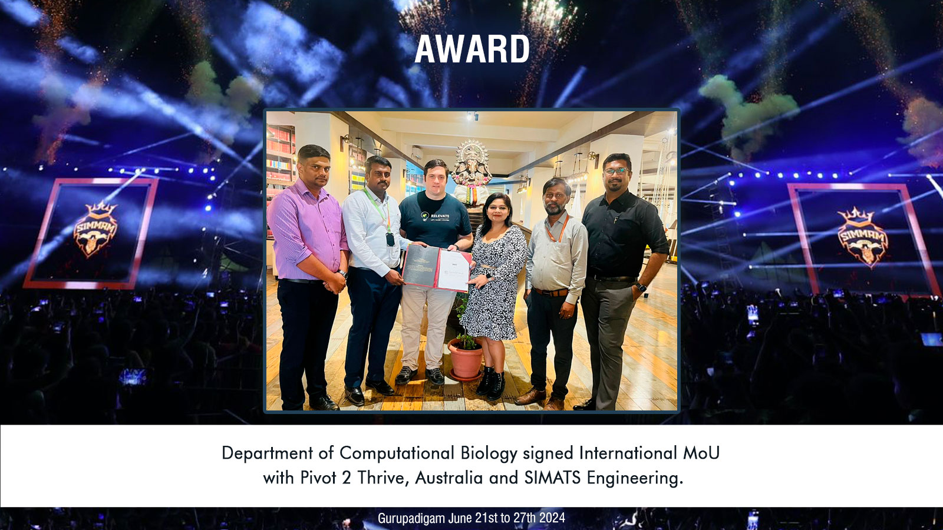

Slide 42

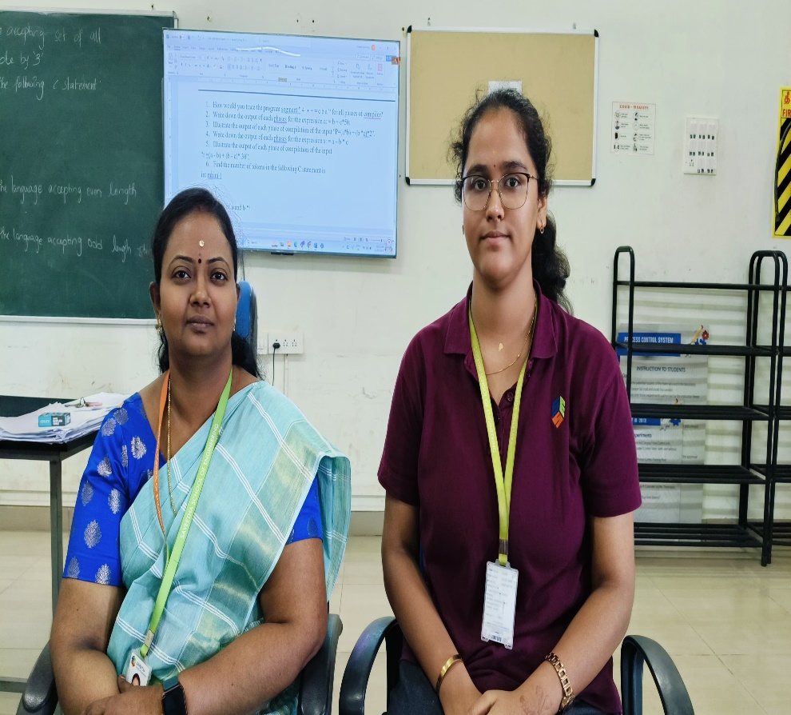
Slot B | Total Marks | Marks Obtained | Class Average Mark
Slot A Attendance : CSA0666 Design and Analysis of Algorithms for Divide and Conquer Techniques- 83%
Theory based class test 6 | 100 | 100 | -
Theory based class test 7 | 100 | 94 | -
Lab based class test 4 | 100 | 100 | -
Hackaton contest | 100 | 100 | -
192371012
VIRINDA SINGH V

Slide 43

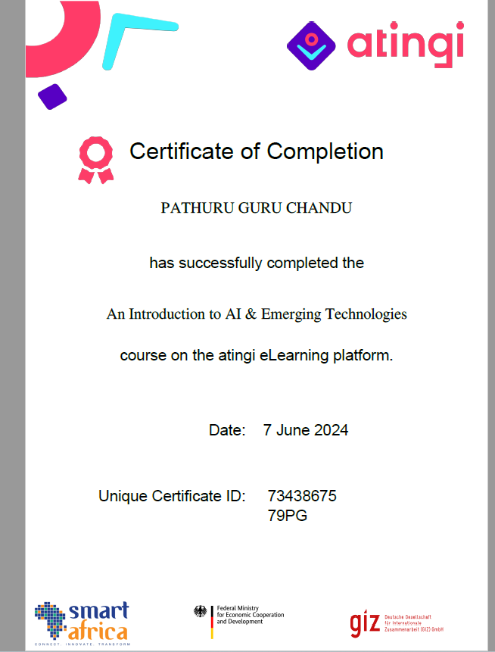
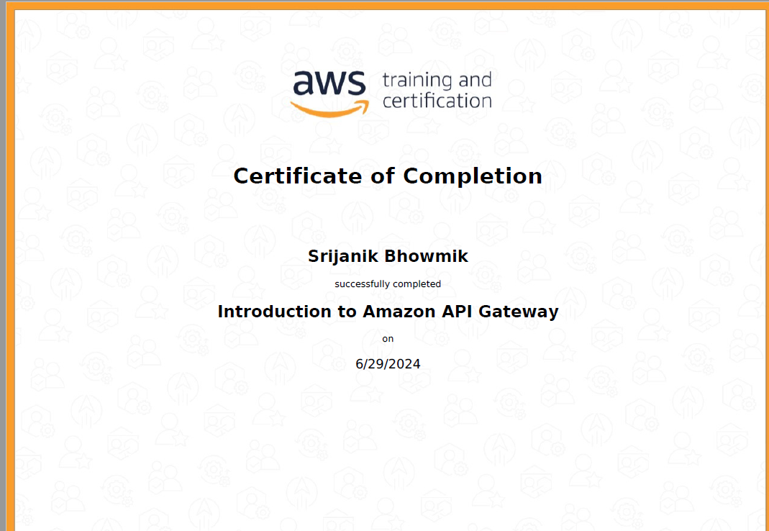
Suggestions to Parents
Dear parents ,
Greetings from Saveetha School of Engineering !!!!!
Congratulations to Pathuru Guru Chandu of the final year for successfully completing a course titled “An Introduction to AI & Emerging Technologies” on the Atingi eLearning Platform. For the 2021 Batch: Classes are planned for PDD and Placement Training. Objectives of PDD: The PDD aims to provide a comprehensive project overview, ensuring clarity, alignment, and a structured approach to project initiation and execution. It is a foundational document that guides the project team throughout its lifecycle, from planning and execution to monitoring and completion. All are asked to complete the Product perfect and market sellable. For the 2022 Batch: There is a plan to launch the course for A, B, C, and D slots. Identify the course for the next phase and ensure you complete the prerequisites for the course. For the 2023 Batch: Regular classes will continue as usual. For First-Year Students of the 2024 Batch: Report to college from July 3rd, 2024 onwards. Pay the fees pending. If already paid, kindly ignore this notice.

Slide 44
MENTEE RESPONSE
PARENT’S RESPONSE
text
text

